Slide 1












$$1.46×{10}^{−4}$$
$$8.79×{10}^{−6}$$
$$1.44×{10}^{−4}$$
$$4.70×{10}^{−6}$$
$$1.54×{10}^{−4}$$
$$3.63×{10}^{−6}$$

Slide 2
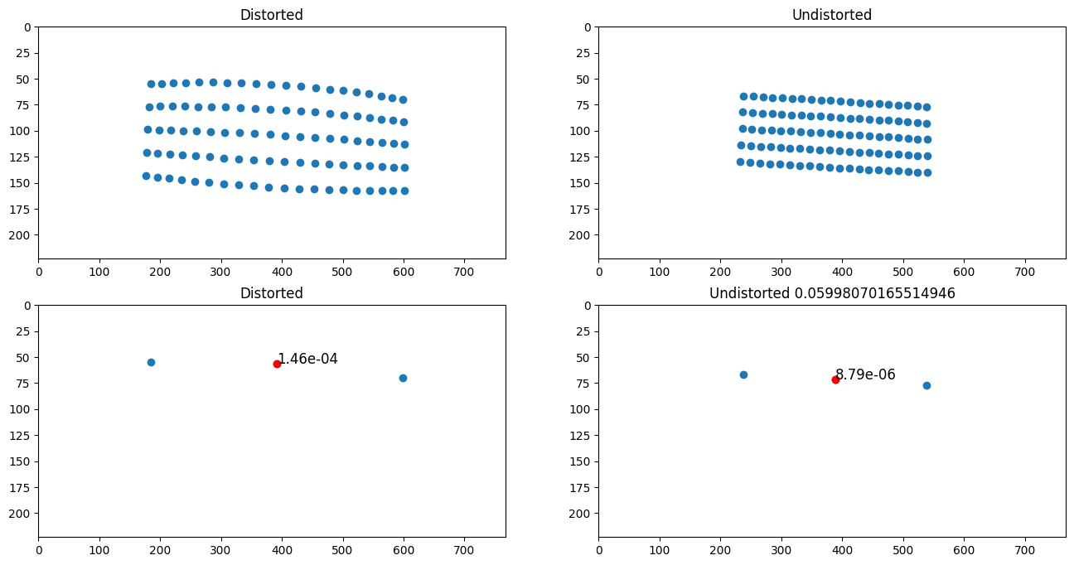

Slide 3
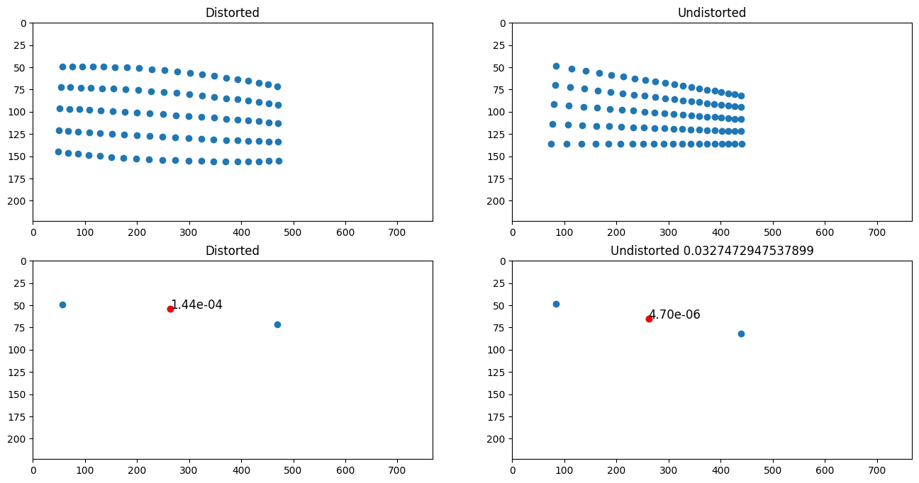

Slide 4
